Slide 1
PRESENTATION TO
FEDERAL HIGHWAY ADMINISTRATION
CITY OF ANNAPOLIS
VALUE CAPTURE
HILLMAN GARAGE
And
CITY DOCK
Nate Betnun
Betnun Consulting
November 14, 2023

Slide 2
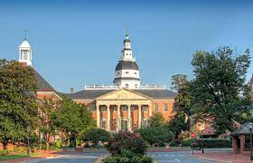
MARYLAND STATE CAPITAL

Slide 3
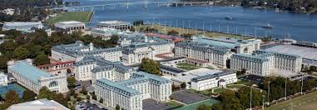
U.S. NAVAL ACADEMY

Slide 4
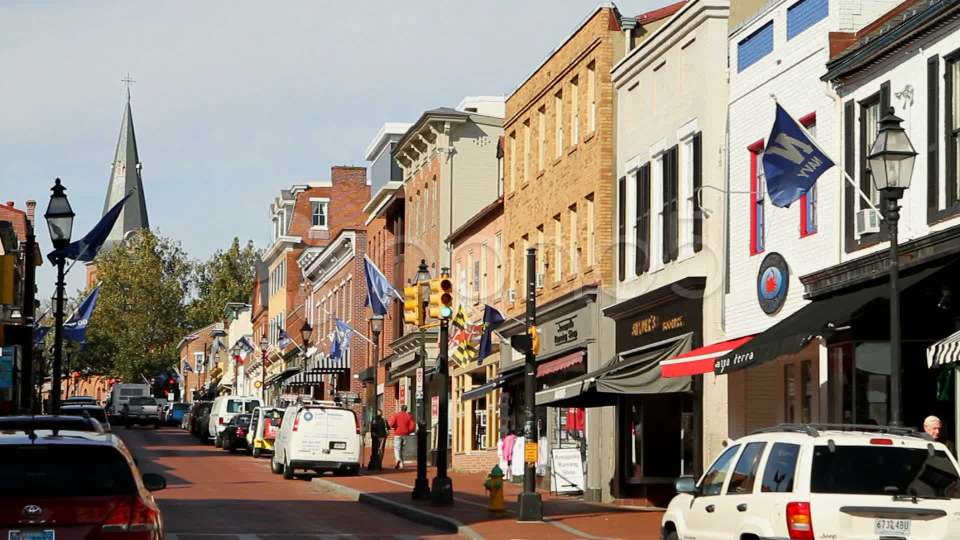
MAIN STREET

Slide 5
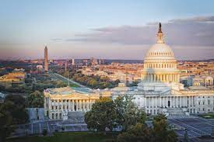
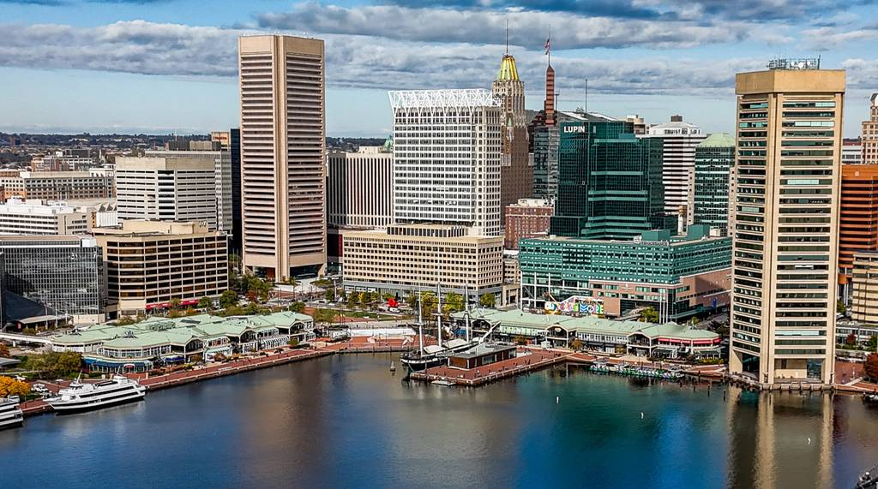
BEDROOM COMMUNITY
Commute to Washington
Commute to Baltimore

Slide 6
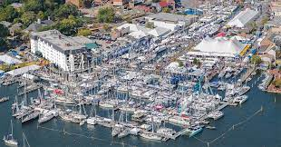
ANNAPOLIS BOATING CAPITAL
World’s largest in-water sailboat show
World’s largest in-water power boat show

Slide 7
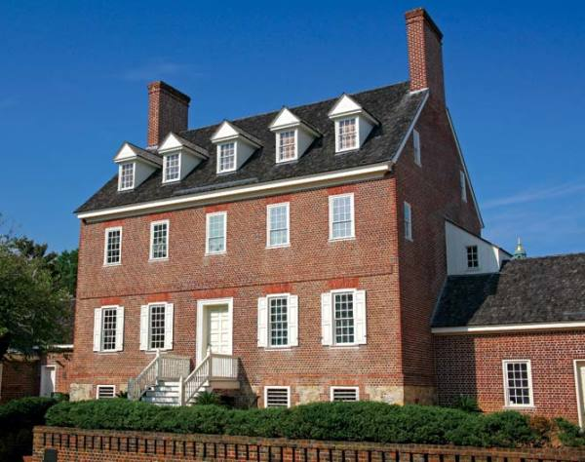
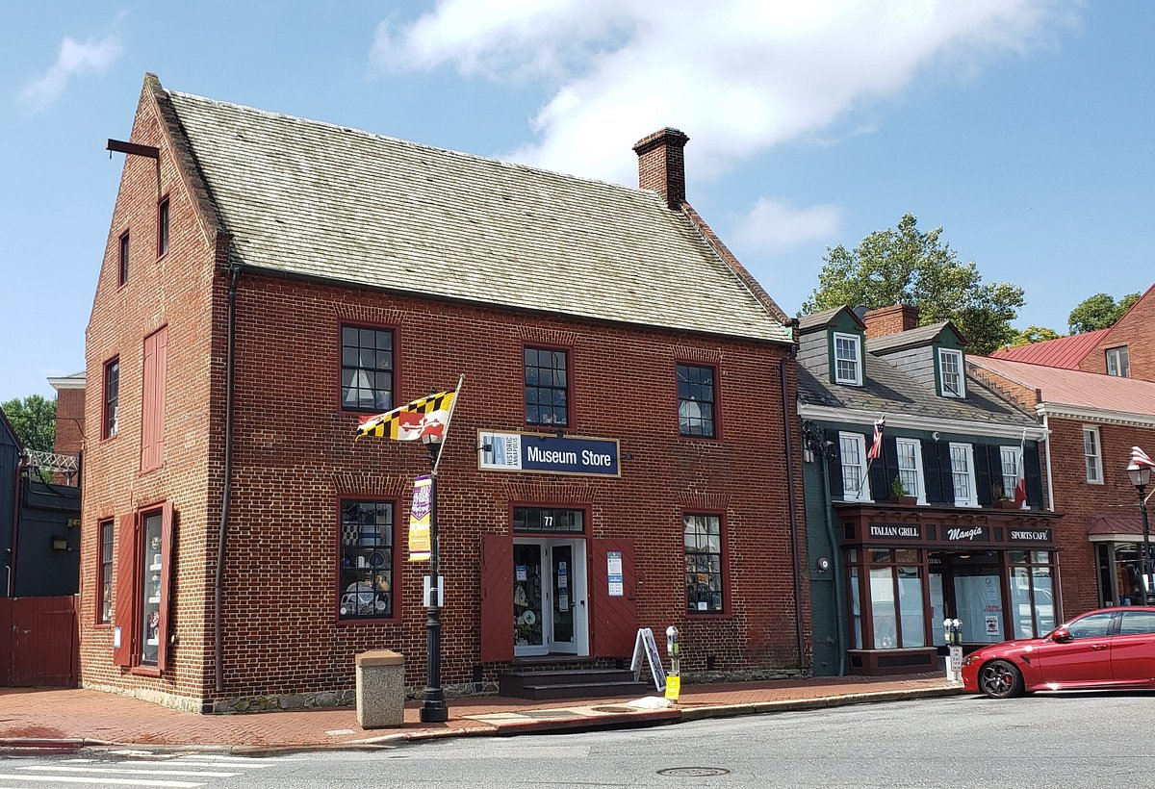
HISTORIC ANNAPOLIS
Annapolis: U.S. capital 1783-1784
Four homes of signers of Declaration of Independence
More 18th Century structures than any other town
Burtis House emblematic of watermen’s historic tie to City Dock

Slide 8
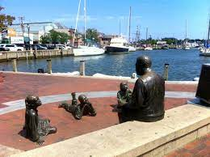
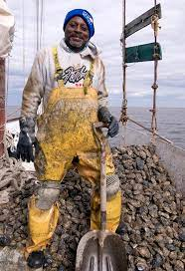
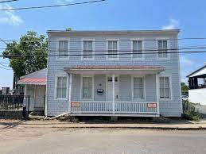
ANNAPOLIS’ OTHER HISTORY
Slave trade
Watermen of the Chesapeake
Burtis House emblematic of watermen’s historic tie to City Dock

Slide 9
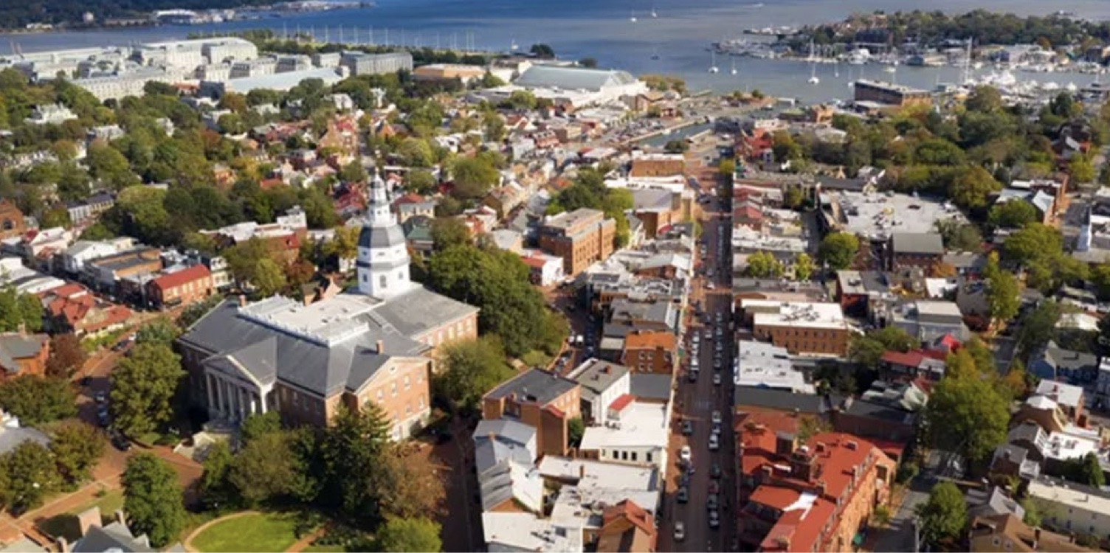
DOWNTOWN ANNAPOLIS
City Dock
Hillman Garage
US Naval Academy
Main Street
Maryland State House

Slide 10
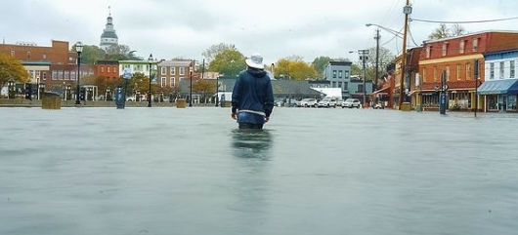
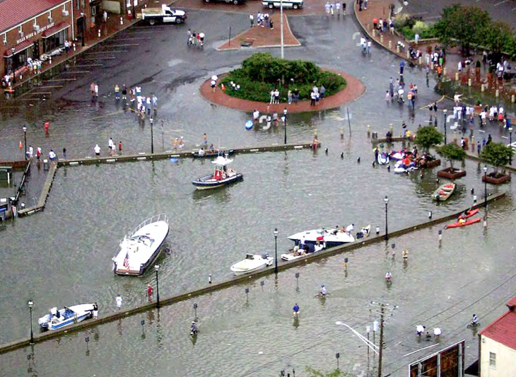
CITY DOCK FLOODING
Year Flood Days
Per Year
4
39
52
2065 365

Slide 11
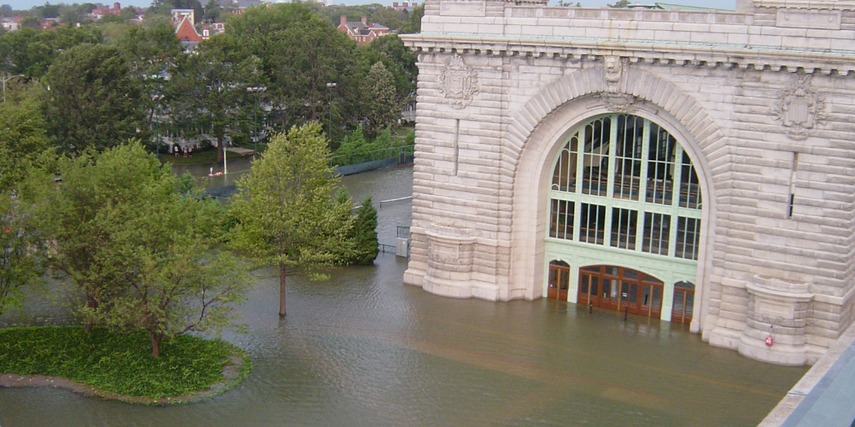
NAVAL ACADEMY FLOODING
9 flood days in 2021
115 annual flood days expected by 2050
$37MM of flood walls under construction
Future section to tie-in with City

Slide 12
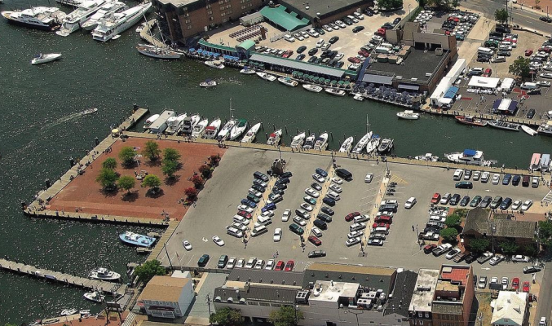
A SEA OF PARKING
282 spaces along City Dock’s prime waterfront

Slide 13
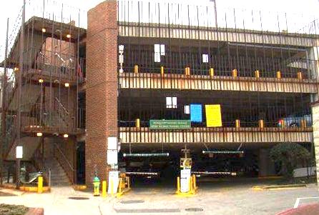
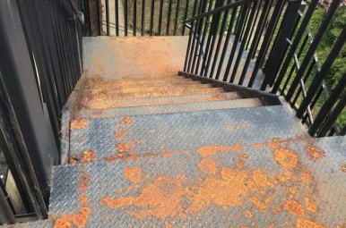
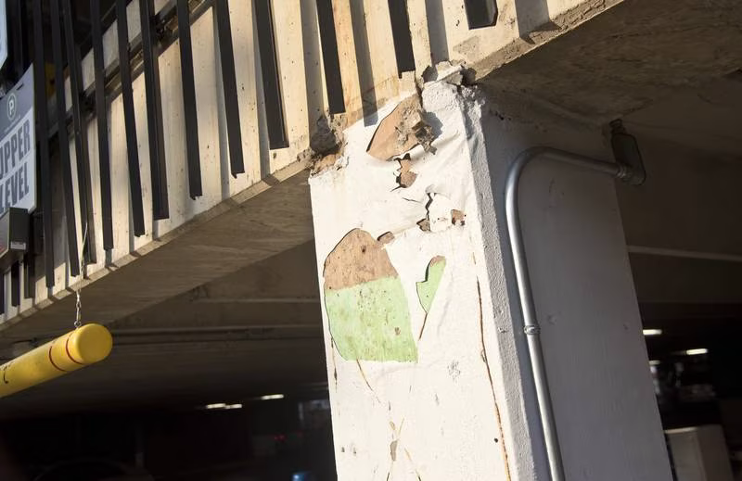
DETERIORATED HILLMAN GARAGE
Built in 1972 with 425 spaces
Brick façade cracked
Walls plastered over by periodic repairs
Rust-colored stains on walls
Elevators not working for years
Rusting outer stairwells
Untreated rainwater runoff

Slide 14

2000 – 2018
EARLY FRUSTRATIONS
Three or four garage committees led to no action.
Multiple City Dock improvement attempts led to minimal action

Slide 15

2000 -2018
OBJECTORS
Merchants: “Don’t take away our parking!”
Taxpayers: “We’re not going to pay for this!”
Historic Annapolis, Inc.: “Save the Burtis House!”
African American Community: ”Make downtown available to our community!”
Boat Show Owners: “Don’t put up barriers!”

Slide 16
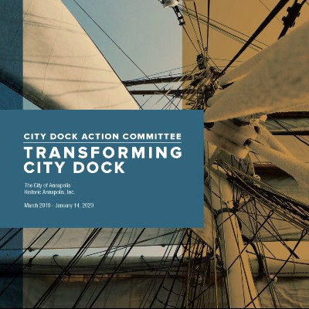
2019 -2020
CITY DOCK ACTION COMMITTEE
Formed in 2019 at behest of Mayor Gavin Buckley
Nearly 100 residents, experts, & stakeholders
After nearly a year of meetings, issued report recommending rebuilding the garage in conjunction with redevelopment of City Dock
Recommended forming a public private partnership

Slide 17





2021
DEVELOPER- PUBLIC PRIVATE PARTNERSHIP
Amber Infrastructure (Hunt Companies) – Developer/Team Leader
Oversee design & construction of garage,
Oversee operations & maintenance of garage,
Design & construct City Dock project.
Whiting-Turner: Contractor
BCT: Architect
Premium Parking: Operator

Slide 18

2022
CONCESSION AGREEMENT
MEDCO, as Concessionaire, responsible for:
Design & construction of Garage,
Operation & maintenance of Garage,
Charging & collection of Parking Fees,
Financing the Garage,
Making Concession Payment to the City.

Slide 19
2022
HILLMAN GARAGE BONDS
Senior Bonds
Due 2053
4.8% Average Rate
Baa3 Moody’s Rating
Subordinate Bonds
10.25% Average Rate
Due 2053 – Non-rated
Sub Bonds Refinanced by City G.O. Bonds
4.35% Average Rate
Aa1/AA+ Ratings
Refi Saved City $8MM PV

Slide 20
Year | Projected Revenues (in $MM) | Projected Expenses (in $MM) | Net Revenues (in $MM) | Senior Bond Debt Service (In $MM) | Senior Bond Debt Service Coverage | Gen. Oblig. Bond Debt Service (in $MM) | Total Debt Service (In $MM) | Net to City (In $MM) | Total Bond Debt Service Coverage
2024 | 5.7 | 0.9 | 4.8 | 1.6 | 3.0x | 1.8 | 3.4 | 1.4 | 1.4x
2025 | 5.9 | 1.0 | 4.9 | 2.4 | 2.0x | 1.8 | 4.2 | 0.7 | 1.2x
2026 | 6.1 | 1.0 | 5.1 | 2.4 | 2.1x | 1.8 | 4.2 | 0.9 | 1.2x
2027 | 6.3 | 1.0 | 5.3 | 2.4 | 2.2x | 1.8 | 4.2 | 1.1 | 1.3x
2028 | 6.4 | 1.1 | 5.4 | 2.4 | 2.2x | 1.8 | 4.2 | 1.2 | 1.3x
2029 | 6.6 | 1.1 | 5.5 | 2.4 | 2.3x | 1.8 | 4.2 | 1.3 | 1.3x
2030 | 6.8 | 1.1 | 5.7 | 2.4 | 2.4x | 1.8 | 4.2 | 1.5 | 1.4x
2031 | 7.0 | 1.1 | 5.9 | 2.4 | 2.4x | 1.8 | 4.2 | 1.7 | 1.4x
2032 | 7.2 | 1.2 | 6.0 | 2.7 | 2.2x | 1.8 | 4.5 | 1.5 | 1.3x
2033 | 7.4 | 1.2 | 6.2 | 2.8 | 2.2x | 1.8 | 4.6 | 1.6 | 1.3x
2034 | 7.6 | 1.2 | 6.4 | 2.9 | 2.2x | 1.8 | 4.7 | 1.7 | 1.4x
2035 | 7.8 | 1.3 | 6.5 | 3.0 | 2.2x | 1.8 | 4.8 | 1.7 | 1.4x
2036 | 8.0 | 1.3 | 6.7 | 3.1 | 2.2x | 1.8 | 4.9 | 1.8 | 1.4x
2037 | 8.2 | 1.3 | 6.9 | 3.2 | 2.2x | 1.8 | 5.0 | 1.9 | 1.4x
2038 | 8.4 | 1.4 | 7.1 | 3.3 | 2.1x | 1.8 | 5.1 | 2.0 | 1.4x
2039 | 8.7 | 1.4 | 7.3 | 3.3 | 2.2x | 1.8 | 5.1 | 2.2 | 1.4x
2040 | 8.9 | 1.4 | 7.5 | 3.5 | 2.1x | 1.8 | 5.3 | 2.2 | 1.4x
2041 | 9.1 | 1.5 | 7.7 | 3.4 | 2.3x | 1.8 | 5.2 | 2.5 | 1.5x
2042 | 9.4 | 1.5 | 7.9 | 3.6 | 2.2x | 1.8 | 5.4 | 2.5 | 1.5x
2043 | 9.6 | 1.5 | 8.1 | 3.7 | 2.2x | 1.8 | 5.5 | 2.6 | 1.5x
2044 | 9.9 | 1.6 | 8.3 | 3.9 | 2.1x | 0.4 | 4.3 | 4.0 | 1.9x
2045 | 10.1 | 1.6 | 8.5 | 3.9 | 2.2x | 0.4 | 4.3 | 4.2 | 2.0x
2046 | 10.4 | 1.7 | 8.7 | 4.0 | 2.2x | 0.4 | 4.4 | 4.3 | 2.0x
2047 | 10.7 | 1.7 | 9.0 | 4.1 | 2.2x | 0.4 | 4.5 | 4.4 | 2.0x
2048 | 10.9 | 1.7 | 9.2 | 4.3 | 2.1x | 0.4 | 4.7 | 4.5 | 1.9x
2049 | 11.2 | 1.8 | 9.4 | 4.4 | 2.1x | 0.4 | 4.8 | 4.6 | 2.0x
2050 | 11.5 | 1.8 | 9.7 | 4.4 | 2.2x | 0.4 | 4.8 | 4.9 | 2.0x
2051 | 11.8 | 1.9 | 9.9 | 4.5 | 2.2x | 0.4 | 4.9 | 5.0 | 2.0x
2052 | 12.1 | 1.9 | 10.2 | 4.4 | 2.3x | 0.4 | 4.8 | 5.4 | 2.1x
2053 | 12.4 | 2.0 | 10.4 | 4.9 | 2.1x | 0.4 | 5.3 | 5.1 | 2.0x
HILLMAN GARAGE CASH FLOWS
Revenues from garage, street meters & small downtown lots
Generally, $1MM+ to City in early years and up to $5MM in backend years
Minimum 2.0x debt service coverage of Senior Bonds
Minimum 1.2x debt service coverage of all Bonds

Slide 21
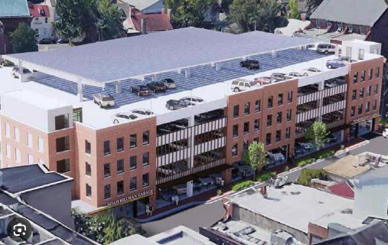
2023
NEW HILLMAN
GARAGE
588 parking spaces; 163 more than before;
Gateless entry and exit;
9 EV charging stations;
594 solar panels on the roof; &
Space counter indicators at entrances

Slide 22
2023
SOURCES (In millions)
Committed Funding
 | State | $15.1
 | Federal EDA | 3.2
 | Federal - Flood | 3.4
 | Federal Delegation | 3.4
 | City Concession Payment | 24.5
 | City - Other | 1.3
 |  | $50.9
Funding Under Review
 | FEMA HMGA | 32.0
Total Sources |  | $82.9
USES (In millions)
 | North Side | $59.0
 | South Side | 29.0
Total Uses |  | $88.0
FUTURE FUNDING NEED |  | $5.1
CITY DOCK FUNDING
Leverage $24.5MM from garage Concession Payment with:
$15MM of State funds
$10MM of committed Fed funds
$32MM of expected FEMA funds

Slide 23
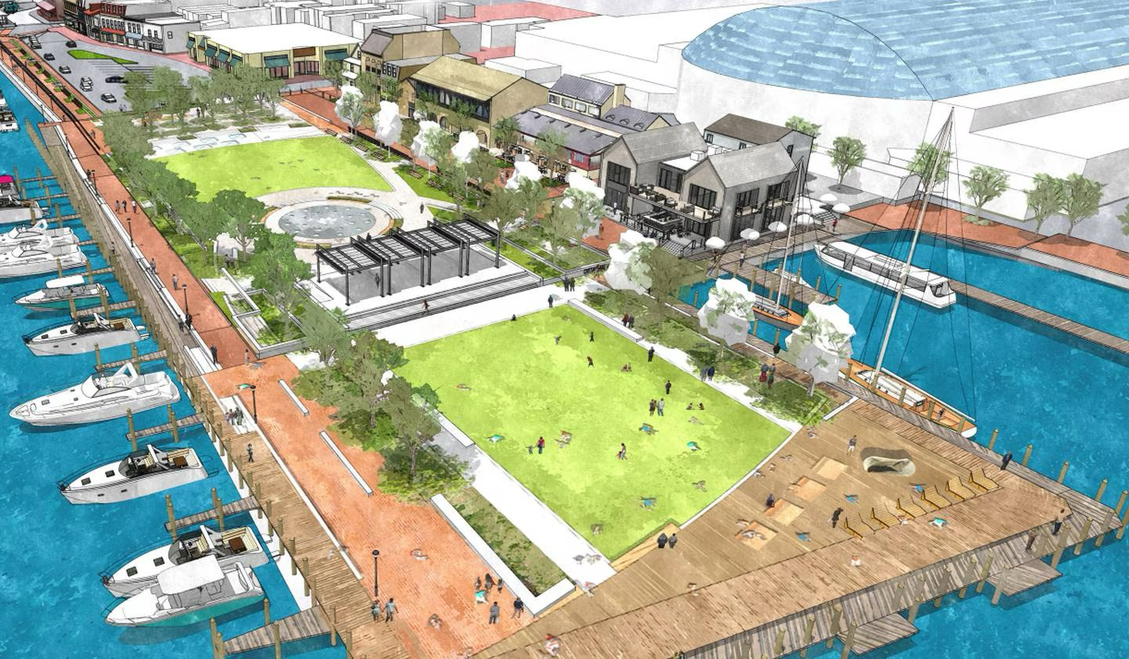
2024- 2025
NEW CITY DOCK
Green space on berm
Interactive Fountain
Pergola stage
Shade trees – movable
Maritime Welcome Center
Harbormaster
Visitor Center
Boaters Lounge
Watermen’s Museum

Slide 24
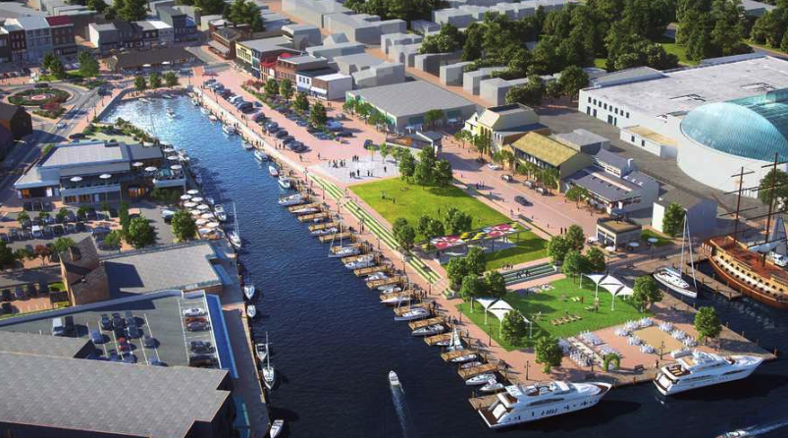

CITY DOCK SECTIONS
Market House
North side
Largely City-owned
South side
Largely private-owned
Restaurant
City Dock Park
Club
Ego Alley
Campbell
Park
Hotel/Restaurant

Slide 25
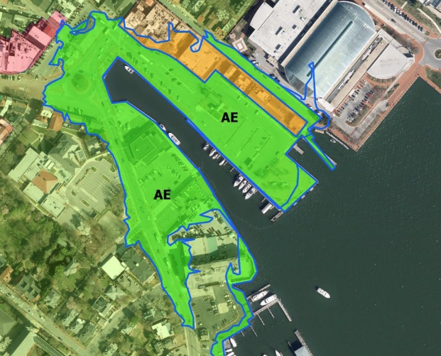
FLOOD
BARRIERS
8-foot protection on both north & south sides
Raised green space to absorb and block floodwaters
Concrete and glass seawalls to stop smaller floods
Flip-up and pop-up panels

Slide 26
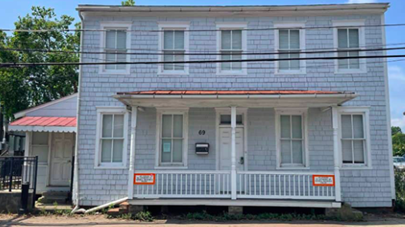

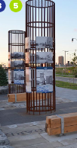
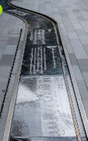
CELEBRATING DIVERSITY
Preserve Burtis House as watermen’s museum
In-ground & above-ground historic commemorations
Cultural walk-abouts

Slide 27
RESULTS
Disparate groups came together
$24.5 million Concession Payment leveraged $15MM from State & $10 million from Feds with another $32MM expected
21st Century garage completed under-budget & ahead of schedule
163 added parking spaces in garage & 120 fewer spaces on City Dock
City Dock to become flood resistant & more attractive to residents & tourists

